Slide 1


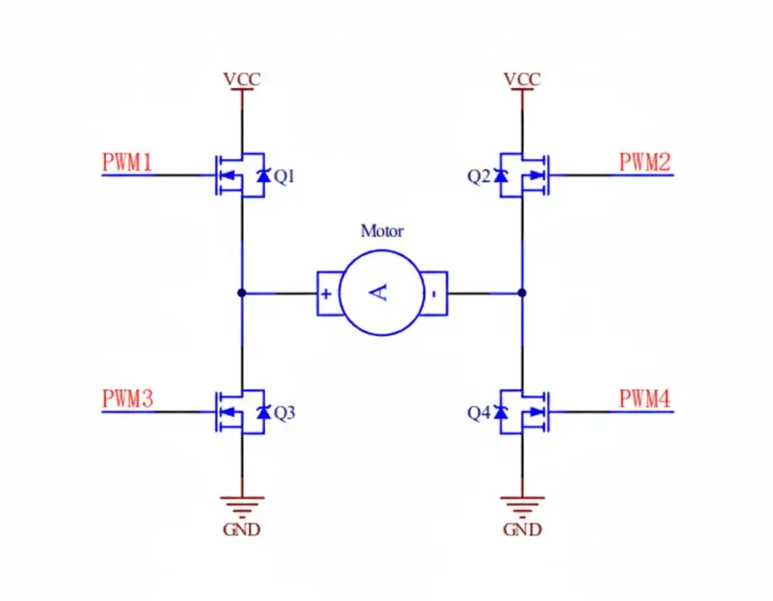
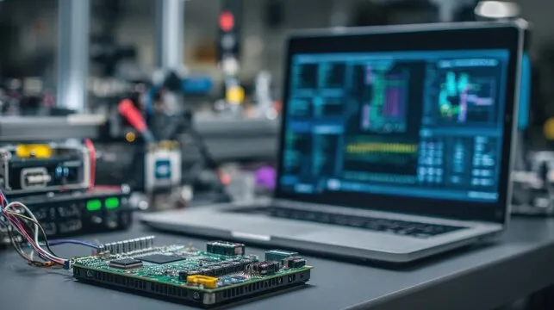
DCLab/Control System Crash Course
DC Motor Drive
and Open-Loop
Control
Dual H-Bridge Mechanics
and Chassis Motion
Session 04
DCLab/Control System Crash Course
01
>_ terminal gremlin (c-lydia ^_^)

Slide 2
00 / Contents
Contents
01
Open-Loop Control
Commands, actuators, plants, and disturbances
02
DC Motors
Voltage balance, torque, and inductive loads
03
H-Bridge Switching
Direction, braking, current decay, and dead time
04
Implementation
Wire, drive, measure, and debug the chassis
Source: course PDF, pp. 1–17
DCLab/Control System Crash Course
02
>_ terminal gremlin (c-lydia ^_^)
Notes:
Reference: DC Motor Drive, Dual H-Bridge Mechanics, and Open Loop Control.pdf, pages 1–17.

Slide 3
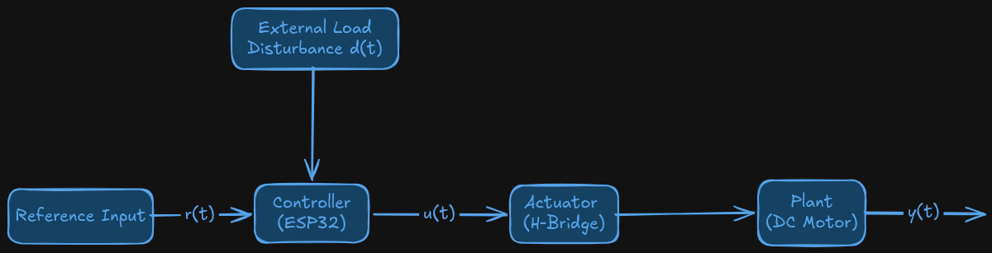
01 / Open-Loop Control
From a Command to Physical Motion
The physical load disturbance acts on the motor and chassis.
Source: course PDF, pp. 1–2
DCLab/Control System Crash Course
03
>_ terminal gremlin (c-lydia ^_^)
Notes:
Reference: DC Motor Drive, Dual H-Bridge Mechanics, and Open Loop Control.pdf, pages 1–2.
Original course artwork retained. Its disturbance arrow points to the controller, but the mechanical load disturbance belongs at the plant. Explain this distinction while walking through the chain.

Slide 4
01 / Open-Loop Control
The Four Functional Blocks
Block
Role
Reference input
Requested speed or motion from the user or planner.
Controller
ESP32 firmware maps the reference to a drive command.
Actuator
H-bridge switches electrical power into the motors.
Plant
Motors, gearboxes, wheels, and chassis produce motion.
A commanded PWM duty is not a measurement of wheel speed.
Source: course PDF, pp. 1–2
DCLab/Control System Crash Course
04
>_ terminal gremlin (c-lydia ^_^)
Notes:
Reference: DC Motor Drive, Dual H-Bridge Mechanics, and Open Loop Control.pdf, pages 1–2.

Slide 5
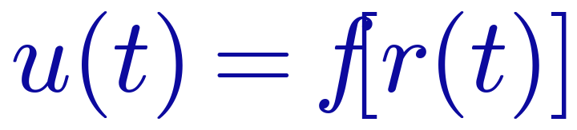
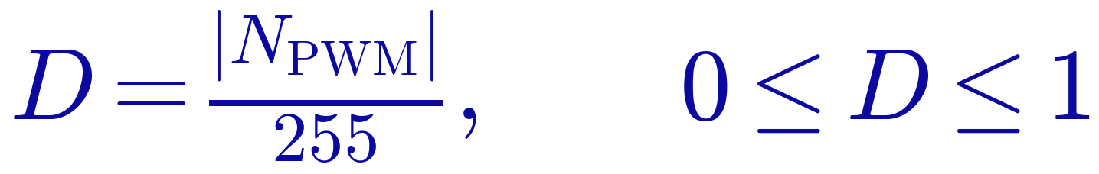

01 / Open-Loop Control
Open-Loop Control: No Output Feedback
The voltage approximation assumes ideal drive/brake PWM and ignores driver losses.
Source: course PDF, pp. 2
DCLab/Control System Crash Course
05
>_ terminal gremlin (c-lydia ^_^)
Notes:
Reference: DC Motor Drive, Dual H-Bridge Mechanics, and Open Loop Control.pdf, pages 2.

Slide 6
01 / Open-Loop Control
Open Loop and Closed Loop
Open loop
The command determines the drive output.
There is no measured speed correction.
Closed loop
Measure actual motion and compare it
with the desired reference.
Trade-off
Open loop is simple; feedback can correct
load-dependent speed errors.
This session establishes the motor-drive layer before adding motion feedback.
Source: course PDF, pp. 2
DCLab/Control System Crash Course
06
>_ terminal gremlin (c-lydia ^_^)
Notes:
Reference: DC Motor Drive, Dual H-Bridge Mechanics, and Open Loop Control.pdf, pages 2.

Slide 7
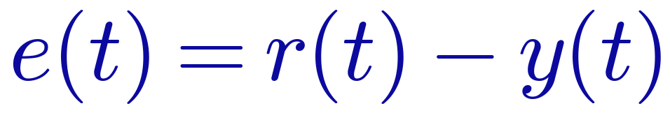
01 / Open-Loop Control
A Disturbance Changes the Actual Speed
Friction, battery sag, and unequal wheel loading can change motion at fixed duty.
Source: course PDF, pp. 1–2
DCLab/Control System Crash Course
07
>_ terminal gremlin (c-lydia ^_^)
Notes:
Reference: DC Motor Drive, Dual H-Bridge Mechanics, and Open Loop Control.pdf, pages 1–2.

Slide 8
02 / DC Motors and Inductive Loads
Keep Logic and Motor Power Separate
ESP32 GPIO
Supplies control signals at 3.3 V logic;
it is not a motor-power output.
Motor supply
Provides the armature current through
the H-bridge and heavy-current return path.
Two failure paths
Excess current can damage GPIO outputs;
inductive switching can produce voltage spikes.
Connect motors to the driver outputs, with a shared logic ground.
Source: course PDF, pp. 2–3
DCLab/Control System Crash Course
08
>_ terminal gremlin (c-lydia ^_^)
Notes:
Reference: DC Motor Drive, Dual H-Bridge Mechanics, and Open Loop Control.pdf, pages 2–3.

Slide 9
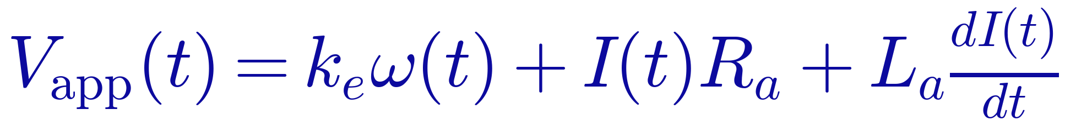
02 / DC Motors and Inductive Loads
The Armature Voltage Balance
Applied voltage balances back EMF, winding resistance, and inductive voltage.
Source: course PDF, pp. 3
DCLab/Control System Crash Course
09
>_ terminal gremlin (c-lydia ^_^)
Notes:
Reference: DC Motor Drive, Dual H-Bridge Mechanics, and Open Loop Control.pdf, pages 3.

Slide 10
02 / DC Motors and Inductive Loads
Read the Motor Model
Symbol
Meaning
Unit
Vapp
Applied terminal voltage
V
ω
Motor-shaft angular speed
rad/s
I
Armature current
A
Ra / La
Winding resistance / inductance
Ω / H
ke / kt
Back-EMF / torque constant
V·s/rad / N·m/A
Keep shaft speed and gearbox output speed distinct when using motor constants.
Source: course PDF, pp. 3
DCLab/Control System Crash Course
10
>_ terminal gremlin (c-lydia ^_^)
Notes:
Reference: DC Motor Drive, Dual H-Bridge Mechanics, and Open Loop Control.pdf, pages 3.

Slide 11
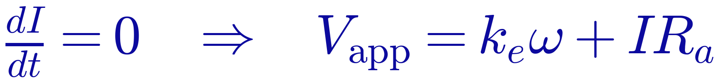
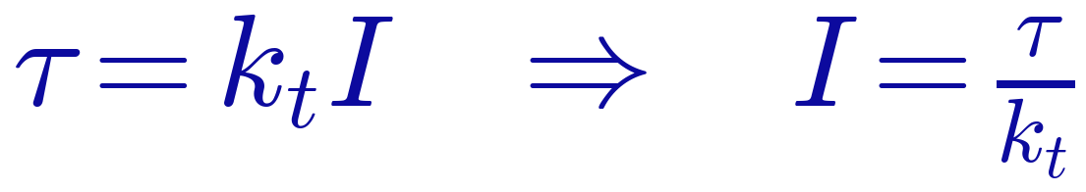
02 / DC Motors and Inductive Loads
Steady-State Voltage and Torque
Torque is proportional to current; back EMF is proportional to shaft speed.
Source: course PDF, pp. 3
DCLab/Control System Crash Course
11
>_ terminal gremlin (c-lydia ^_^)
Notes:
Reference: DC Motor Drive, Dual H-Bridge Mechanics, and Open Loop Control.pdf, pages 3.

Slide 12

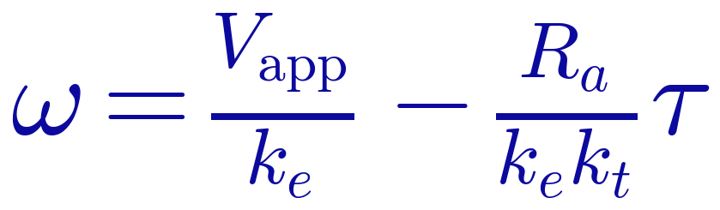
02 / DC Motors and Inductive Loads
Derive the Speed–Torque Relationship
The slope is −Ra/(ke kt); the squared term applies to kt, not to Ra.
Source: course PDF, pp. 3
DCLab/Control System Crash Course
12
>_ terminal gremlin (c-lydia ^_^)
Notes:
Reference: DC Motor Drive, Dual H-Bridge Mechanics, and Open Loop Control.pdf, pages 3.

Slide 13

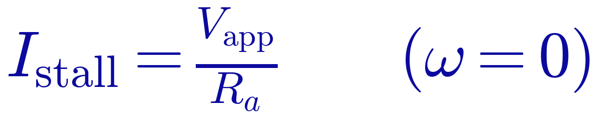

02 / DC Motors and Inductive Loads
No-Load and Stall Limits
Stall is a high-current condition; real no-load current also supplies motor losses.
Source: course PDF, pp. 3–4
DCLab/Control System Crash Course
13
>_ terminal gremlin (c-lydia ^_^)
Notes:
Reference: DC Motor Drive, Dual H-Bridge Mechanics, and Open Loop Control.pdf, pages 3–4.

Slide 14
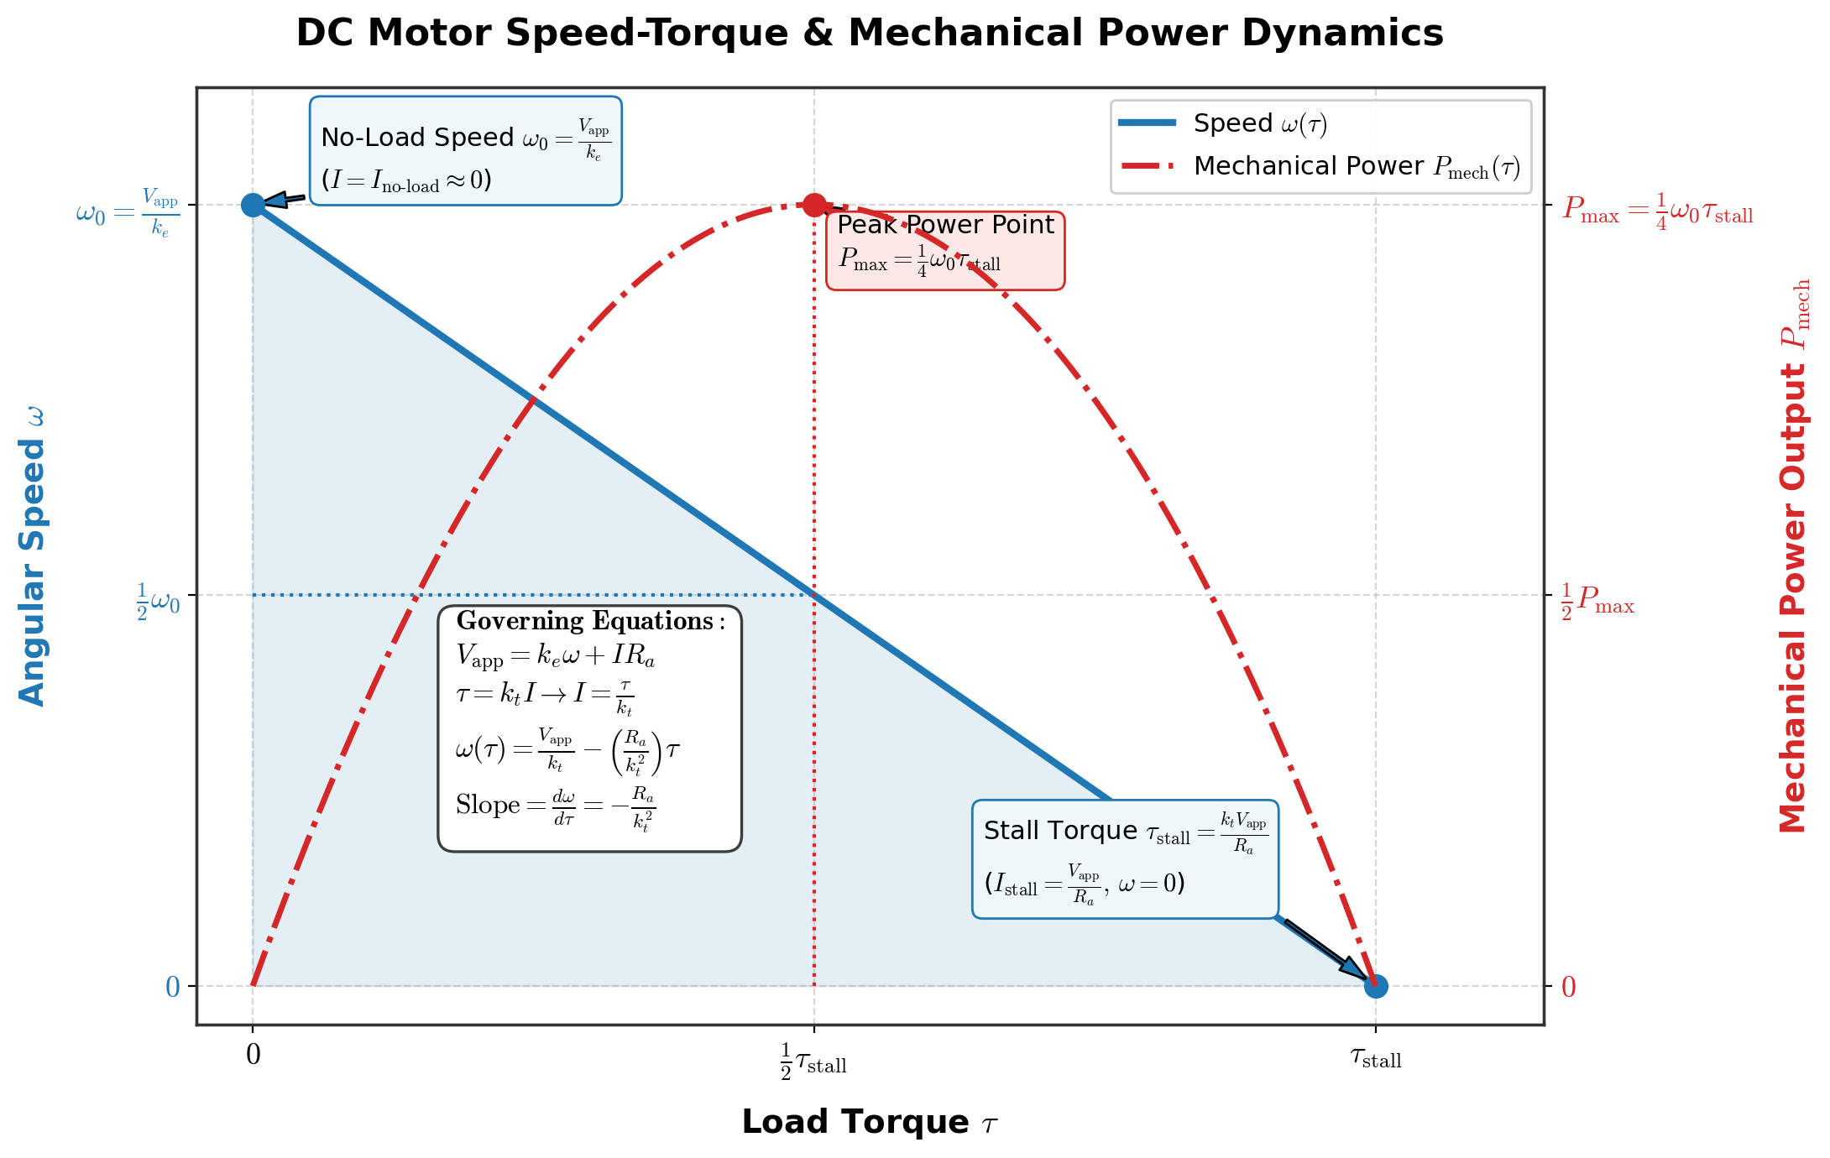
02 / DC Motors and Inductive Loads
Speed, Torque, and Mechanical Power
Original course figure: ideal speed falls as load torque increases.
Source: course PDF, pp. 4
DCLab/Control System Crash Course
14
>_ terminal gremlin (c-lydia ^_^)
Notes:
Reference: DC Motor Drive, Dual H-Bridge Mechanics, and Open Loop Control.pdf, pages 4.

Slide 15

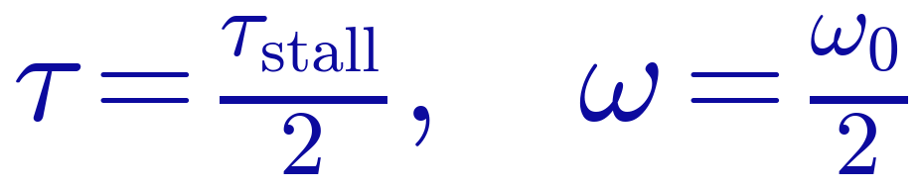

02 / DC Motors and Inductive Loads
Mechanical Power Along the Curve
This ideal peak-power point is not a continuous operating recommendation.
Source: course PDF, pp. 4
DCLab/Control System Crash Course
15
>_ terminal gremlin (c-lydia ^_^)
Notes:
Reference: DC Motor Drive, Dual H-Bridge Mechanics, and Open Loop Control.pdf, pages 4.

Slide 16


02 / DC Motors and Inductive Loads
Parallel Motors Add Channel Current
Arithmetic uses the PDF’s per-motor example; measure the actual motor demand.
Source: course PDF, pp. 2, 8
DCLab/Control System Crash Course
16
>_ terminal gremlin (c-lydia ^_^)
Notes:
Reference: DC Motor Drive, Dual H-Bridge Mechanics, and Open Loop Control.pdf, pages 2, 8.

Slide 17

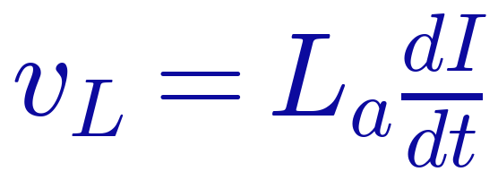
02 / DC Motors and Inductive Loads
Inductive Energy and Switching Voltage
Current cannot change instantaneously: switching must provide a recirculation path.
Source: course PDF, pp. 4–5
DCLab/Control System Crash Course
17
>_ terminal gremlin (c-lydia ^_^)
Notes:
Reference: DC Motor Drive, Dual H-Bridge Mechanics, and Open Loop Control.pdf, pages 4–5.

Slide 18
02 / DC Motors and Inductive Loads
Flyback and Current Recirculation
Switch turns off
Stored magnetic energy keeps armature
current flowing in its original direction.
Current path
Body diodes or driven MOSFETs provide
a path while the winding current decays.
Supply behavior
Some paths return energy to the supply;
rail voltage and decoupling still matter.
The recirculation path depends on the driver state and current direction.
Source: course PDF, pp. 4–5
DCLab/Control System Crash Course
18
>_ terminal gremlin (c-lydia ^_^)
Notes:
Reference: DC Motor Drive, Dual H-Bridge Mechanics, and Open Loop Control.pdf, pages 4–5.

Slide 19
03 / H-Bridge Switching
The Four-Switch H-Bridge
Use the picture numbering: Q1/Q2 are high-side; Q3/Q4 are low-side.
Source: course PDF, pp. 5–6
DCLab/Control System Crash Course
19
>_ terminal gremlin (c-lydia ^_^)
Notes:
Reference: DC Motor Drive, Dual H-Bridge Mechanics, and Open Loop Control.pdf, pages 5–6.
The PDF prose labels Q1/Q3 high-side, unlike this image. All tables and editable diagrams in this deck follow the image labels.

Slide 20
03 / H-Bridge Switching
Forward and Reverse Current Paths
FORWARD / Q1 + Q4
REVERSE / Q2 + Q3
VM
VM
Q1
Q2
Q1
Q2
M
M
Q3
Q4
Q3
Q4
GND
GND
Select one diagonal pair; motor wiring determines the physical rotation direction.
Source: course PDF, pp. 6
DCLab/Control System Crash Course
20
>_ terminal gremlin (c-lydia ^_^)
Notes:
Reference: DC Motor Drive, Dual H-Bridge Mechanics, and Open Loop Control.pdf, pages 6.

Slide 21
03 / H-Bridge Switching
Ideal Switch States
Mode
Q1
Q2
Q3
Q4
Motor state
Forward
ON
OFF
OFF
ON
+VM
Reverse
OFF
ON
ON
OFF
−VM
Low-side brake
OFF
OFF
ON
ON
Terminals shorted
Coast command
OFF
OFF
OFF
OFF
Outputs high-Z
These are transistor states, not the integrated driver’s input truth table.
Source: course PDF, pp. 6–7
DCLab/Control System Crash Course
21
>_ terminal gremlin (c-lydia ^_^)
Notes:
Reference: DC Motor Drive, Dual H-Bridge Mechanics, and Open Loop Control.pdf, pages 6–7.

Slide 22
03 / H-Bridge Switching
Braking and Coasting Are Different
Dynamic braking
Both motor terminals are tied together.
Generated current opposes the ongoing motion.
Coasting
Outputs are high impedance; the rotor slows
through mechanical and electrical losses.
During PWM
Current decay describes the winding current
during the inactive part of each PWM cycle.
Do not use “brake/coast” and “fast/slow decay” as interchangeable names.
Source: course PDF, pp. 6–7
DCLab/Control System Crash Course
22
>_ terminal gremlin (c-lydia ^_^)
Notes:
Reference: DC Motor Drive, Dual H-Bridge Mechanics, and Open Loop Control.pdf, pages 6–7.

Slide 23
03 / H-Bridge Switching
Slow and Fast Current Decay
Slow decay
Shorted-terminal recirculation usually applies
a relatively small opposing winding voltage.
Fast decay
A path through the opposite diagonal or
diodes applies a larger opposing voltage.
Practical effect
The off-state changes current ripple,
response speed, and the duty-to-speed relation.
Include back EMF and resistance when analyzing a rotating motor.
Source: course PDF, pp. 7
DCLab/Control System Crash Course
23
>_ terminal gremlin (c-lydia ^_^)
Notes:
Reference: DC Motor Drive, Dual H-Bridge Mechanics, and Open Loop Control.pdf, pages 7.

Slide 24
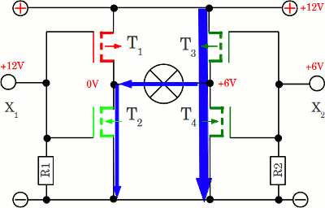
03 / H-Bridge Switching
Shoot-Through: A Supply Short Circuit
Never turn on the high-side and low-side switches of the same leg together.
Source: course PDF, pp. 7
DCLab/Control System Crash Course
24
>_ terminal gremlin (c-lydia ^_^)
Notes:
Reference: DC Motor Drive, Dual H-Bridge Mechanics, and Open Loop Control.pdf, pages 7.

Slide 25
03 / H-Bridge Switching
Dead Time Between Complementary Switches
HIGH-SIDE
Both switches OFF
LOW-SIDE
The integrated driver inserts dead time; motor reversal is a separate current transient.
Source: course PDF, pp. 8
DCLab/Control System Crash Course
25
>_ terminal gremlin (c-lydia ^_^)
Notes:
Reference: DC Motor Drive, Dual H-Bridge Mechanics, and Open Loop Control.pdf, pages 8.
TB6612FNG datasheet confirms internal dead time. Avoid the PDF’s universal immunity claim and generic timing inequality. https://toshiba.semicon-storage.com/info/datasheet_en_20141001.pdf?did=10660

Slide 26
03 / H-Bridge Switching
TB6612FNG: Command the Actual IC
STBY
IN1
IN2
PWM
Output mode
LOW
X
X
X
Standby / high-Z
HIGH
HIGH
LOW
HIGH
Forward polarity
HIGH
LOW
HIGH
HIGH
Reverse polarity
HIGH
HIGH
HIGH
X
Short brake
HIGH
LOW
LOW
HIGH
Stop / high-Z
HIGH
HIGH
LOW
LOW
Short brake (PWM off)
X = either level. Use the actual driver table when choosing stop and PWM behavior.
Source: course PDF, pp. 6–8, 11–12
DCLab/Control System Crash Course
26
>_ terminal gremlin (c-lydia ^_^)
Notes:
Reference: DC Motor Drive, Dual H-Bridge Mechanics, and Open Loop Control.pdf, pages 6–8, 11–12.
https://toshiba.semicon-storage.com/info/datasheet_en_20141001.pdf?did=10660

Slide 27
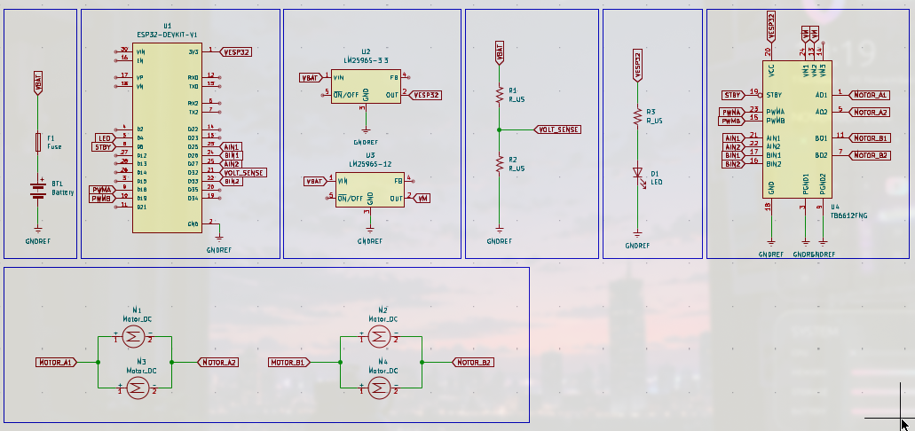
04 / Implementation
The Complete Motor-Drive Schematic
Original drawing: follow net labels between ESP32, driver, and the two motor pairs.
Source: course PDF, pp. 8
DCLab/Control System Crash Course
27
>_ terminal gremlin (c-lydia ^_^)
Notes:
Reference: DC Motor Drive, Dual H-Bridge Mechanics, and Open Loop Control.pdf, pages 8.

Slide 28
04 / Implementation
Schematic: ESP32 Control Signals
CHANNEL A
PWMA → GPIO 18
AIN1/AIN2 → 25/27
CHANNEL B
PWMB → GPIO 19
BIN1/BIN2 → 26/33
ENABLE
STBY → GPIO 5
Common GND reference
GPIO numbers identify ESP32 signals; they are not the driver IC’s package pin numbers.
Source: course PDF, pp. 8
DCLab/Control System Crash Course
28
>_ terminal gremlin (c-lydia ^_^)
Notes:
Reference: DC Motor Drive, Dual H-Bridge Mechanics, and Open Loop Control.pdf, pages 8.

Slide 29
04 / Implementation
Schematic: TB6612FNG Connections
CONTROL
Direction inputs, PWM,
and active-high STBY.
SUPPLIES
VCC is logic supply;
VM is motor supply.
OUTPUTS
AO1/AO2 → left pair;
BO1/BO2 → right pair.
Connect power ground and logic ground to the common reference.
Source: course PDF, pp. 8
DCLab/Control System Crash Course
29
>_ terminal gremlin (c-lydia ^_^)
Notes:
Reference: DC Motor Drive, Dual H-Bridge Mechanics, and Open Loop Control.pdf, pages 8.

Slide 30
04 / Implementation
Schematic: Two Motors per Channel
LEFT PAIR
M1 and M3 share
the channel A outputs.
RIGHT PAIR
M2 and M4 share
the channel B outputs.
CHECK POLARITY
Paired wheels must
propel the same side.
Parallel motors share voltage; their currents add at the driver channel.
Source: course PDF, pp. 8
DCLab/Control System Crash Course
30
>_ terminal gremlin (c-lydia ^_^)
Notes:
Reference: DC Motor Drive, Dual H-Bridge Mechanics, and Open Loop Control.pdf, pages 8.

Slide 31
04 / Implementation
Resolve the Supply Labels Before Wiring
Original drawing
The buck symbols are labeled 3.3 V and 12 V;
the text describes 5 V VIN and a 6 V motor rail.
Logic supply
Use a compatible logic supply for 3.3 V
ESP32 outputs; distinguish VCC from VM.
Motor rating
The notes list 5 V gearmotors. Confirm their
allowed voltage before using the 6 V example.
Set the rail to suit the actual motor; lower duty still applies full-voltage PWM pulses.
Source: course PDF, pp. 8, 16
DCLab/Control System Crash Course
31
>_ terminal gremlin (c-lydia ^_^)
Notes:
Reference: DC Motor Drive, Dual H-Bridge Mechanics, and Open Loop Control.pdf, pages 8, 16.
Schematic/procedure mismatch made explicit. TB6612FNG logic threshold is relative to VCC. https://toshiba.semicon-storage.com/info/datasheet_en_20141001.pdf?did=10660

Slide 32
04 / Implementation
Firmware Pin Map
Function
Left / Channel A
Right / Channel B
PWM
GPIO 18 / LEDC 0
GPIO 19 / LEDC 1
Direction IN1
GPIO 25
GPIO 26
Direction IN2
GPIO 27
GPIO 33
Shared enable
STBY: GPIO 5
STBY: GPIO 5
Supporting I/O
Heartbeat: GPIO 4
Battery ADC: GPIO 32
The firmware uses two independent PWM channels at 20 kHz and 8-bit resolution.
Source: course PDF, pp. 8–10
DCLab/Control System Crash Course
32
>_ terminal gremlin (c-lydia ^_^)
Notes:
Reference: DC Motor Drive, Dual H-Bridge Mechanics, and Open Loop Control.pdf, pages 8–10.

Slide 33
04 / Implementation
Signed Commands Produce Chassis Motion
FORWARD
REVERSE
SPIN LEFT
L + / R +
L − / R −
L − / R +
Check the physical wheel direction before interpreting command signs.
Source: course PDF, pp. 12–13
DCLab/Control System Crash Course
33
>_ terminal gremlin (c-lydia ^_^)
Notes:
Reference: DC Motor Drive, Dual H-Bridge Mechanics, and Open Loop Control.pdf, pages 12–13.

Slide 34
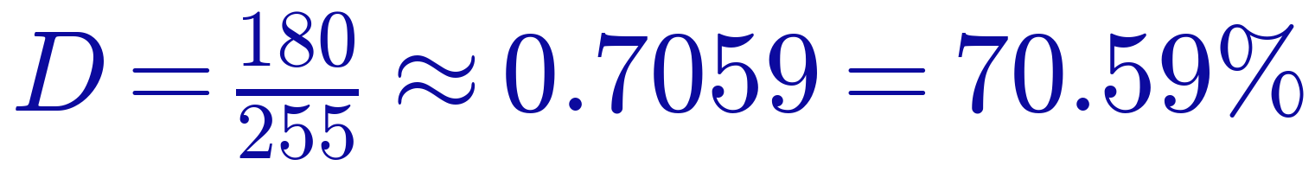
04 / Implementation
Calculate Duty and Expected Average Voltage
Ideal 6 V reference example; driver losses and meter response change measured values.
Source: course PDF, pp. 2, 13, 16
DCLab/Control System Crash Course
34
>_ terminal gremlin (c-lydia ^_^)
Notes:
Reference: DC Motor Drive, Dual H-Bridge Mechanics, and Open Loop Control.pdf, pages 2, 13, 16.

Slide 35
04 / Implementation
The Source Demo: An Eight-Second Sequence
Time in cycle
Left duty
Right duty
Motion
0–2 s
+180
+180
Forward
2–4 s
−180
−180
Reverse
4–6 s
−150
+150
Spin left
6–8 s
0
0
Stop
This is a step sequence, not a ramp. Test one mode at a time before sequencing.
Source: course PDF, pp. 13
DCLab/Control System Crash Course
35
>_ terminal gremlin (c-lydia ^_^)
Notes:
Reference: DC Motor Drive, Dual H-Bridge Mechanics, and Open Loop Control.pdf, pages 13.

Slide 36
04 / Implementation
Keep Motion and Logging at Different Rates
MOTION
TELEMETRY
HEARTBEAT
100 Hz
10 Hz
1 Hz task
Apply left/right
commands every 10 ms.
Report duty, battery,
and driver state.
Toggle the status LED
every second.
Hardware PWM runs independently at 20 kHz.
Source: course PDF, pp. 13–16
DCLab/Control System Crash Course
36
>_ terminal gremlin (c-lydia ^_^)
Notes:
Reference: DC Motor Drive, Dual H-Bridge Mechanics, and Open Loop Control.pdf, pages 13–16.

Slide 37
04 / Implementation / Key Firmware
Start with the Driver Disabled
pinMode(PIN_STBY, OUTPUT);
digitalWrite(PIN_STBY, LOW);
digitalWrite(PIN_AIN1, LOW);
digitalWrite(PIN_AIN2, LOW);
digitalWrite(PIN_BIN1, LOW);
digitalWrite(PIN_BIN2, LOW);
Configure direction pins as outputs first; keep STBY low during initialization.
Source: course PDF, pp. 10
DCLab/Control System Crash Course
37
>_ terminal gremlin (c-lydia ^_^)
Notes:
Reference: DC Motor Drive, Dual H-Bridge Mechanics, and Open Loop Control.pdf, pages 10.

Slide 38
04 / Implementation / Key Firmware
Attach the Two PWM Channels
bool left_ok = ledcAttachChannel(
PIN_PWMA, 20000, 8, LEDC_CHANNEL_LEFT);
bool right_ok = ledcAttachChannel(
PIN_PWMB, 20000, 8, LEDC_CHANNEL_RIGHT);
if (!left_ok || !right_ok) return false;
ledcWrite(PIN_PWMA, 0);
ledcWrite(PIN_PWMB, 0);
Enable STBY only after PWM initialization succeeds and both duties are zero.
Source: course PDF, pp. 10–11
DCLab/Control System Crash Course
38
>_ terminal gremlin (c-lydia ^_^)
Notes:
Reference: DC Motor Drive, Dual H-Bridge Mechanics, and Open Loop Control.pdf, pages 10–11.

Slide 39
04 / Implementation / Key Firmware
Positive Command: Forward Polarity
duty_count = constrain(duty_count, -255, 255);
if (duty_count > 0) {
digitalWrite(PIN_AIN1, HIGH);
digitalWrite(PIN_AIN2, LOW);
ledcWrite(PIN_PWMA, uint8_t(duty_count));
}
Inside setLeftMotorSpeed(): magnitude controls duty; direction inputs set polarity.
Source: course PDF, pp. 11
DCLab/Control System Crash Course
39
>_ terminal gremlin (c-lydia ^_^)
Notes:
Reference: DC Motor Drive, Dual H-Bridge Mechanics, and Open Loop Control.pdf, pages 11.

Slide 40
04 / Implementation / Key Firmware
Negative Command: Reverse Polarity
else if (duty_count < 0) {
digitalWrite(PIN_AIN1, LOW);
digitalWrite(PIN_AIN2, HIGH);
ledcWrite(PIN_PWMA, uint8_t(-duty_count));
}
Mirror the same logic for channel B; manage reversal transients before high-load tests.
Source: course PDF, pp. 11–12
DCLab/Control System Crash Course
40
>_ terminal gremlin (c-lydia ^_^)
Notes:
Reference: DC Motor Drive, Dual H-Bridge Mechanics, and Open Loop Control.pdf, pages 11–12.

Slide 41
04 / Implementation / Key Firmware
Zero Command: Explicit Short Brake
else {
digitalWrite(PIN_AIN1, HIGH);
digitalWrite(PIN_AIN2, HIGH);
ledcWrite(PIN_PWMA, 0);
}
TB6612FNG: both direction inputs HIGH explicitly select short brake.
Source: course PDF, pp. 11–12
DCLab/Control System Crash Course
41
>_ terminal gremlin (c-lydia ^_^)
Notes:
Reference: DC Motor Drive, Dual H-Bridge Mechanics, and Open Loop Control.pdf, pages 11–12.
Corrected teaching excerpt: source uses both inputs LOW and PWM zero while calling it fast-decay braking. Use the documented HIGH/HIGH short-brake command with STBY high. https://toshiba.semicon-storage.com/info/datasheet_en_20141001.pdf?did=10660

Slide 42
04 / Implementation / Key Firmware
Apply Independent Left and Right Commands
void driveRobot(int16_t left, int16_t right) {
left_command_duty = constrain(left, -255, 255);
right_command_duty = constrain(right, -255, 255);
setLeftMotorSpeed(left_command_duty);
setRightMotorSpeed(right_command_duty);
}
Store the bounded commands so telemetry agrees with the PWM values sent to the driver.
Source: course PDF, pp. 12
DCLab/Control System Crash Course
42
>_ terminal gremlin (c-lydia ^_^)
Notes:
Reference: DC Motor Drive, Dual H-Bridge Mechanics, and Open Loop Control.pdf, pages 12.

Slide 43
04 / Implementation / Key Firmware
Run the Motion Task at 100 Hz
if (uint32_t(current_us - last_motion_time_us)
>= INTERVAL_MOTION_US) {
last_motion_time_us += INTERVAL_MOTION_US;
task_motion_control();
}
Use the existing 10 Hz telemetry and 1 Hz heartbeat checks alongside this one.
Source: course PDF, pp. 15–16
DCLab/Control System Crash Course
43
>_ terminal gremlin (c-lydia ^_^)
Notes:
Reference: DC Motor Drive, Dual H-Bridge Mechanics, and Open Loop Control.pdf, pages 15–16.

Slide 44
04 / Implementation
Bench Setup Before the First Motion
Power disconnected
Verify common ground, wiring polarity,
and that no supply rail has a persistent short.
Wheels clear
Secure the chassis with wheels off the bench.
Keep access to the power disconnect.
One step at a time
Start at low duty on one channel; confirm
both paired wheels move in the intended direction.
Stop before reversing during initial tests; build up to the source demonstration.
Source: course PDF, pp. 8, 16
DCLab/Control System Crash Course
44
>_ terminal gremlin (c-lydia ^_^)
Notes:
Reference: DC Motor Drive, Dual H-Bridge Mechanics, and Open Loop Control.pdf, pages 8, 16.

Slide 45
04 / Implementation
Verify Logic Supply, Motor Supply, and Enable
Logic rail
The course target is 5.00 V ± 0.05 V
at ESP32 VIN; check driver VCC separately.
Motor rail
Measure VM relative to power ground.
Use the voltage appropriate to the actual motors.
Standby input
STBY low disables the outputs.
Confirm the intended enable level at the driver.
Check rail voltage under load, not only with the motors disconnected.
Source: course PDF, pp. 16
DCLab/Control System Crash Course
45
>_ terminal gremlin (c-lydia ^_^)
Notes:
Reference: DC Motor Drive, Dual H-Bridge Mechanics, and Open Loop Control.pdf, pages 16.

Slide 46
04 / Implementation
Measure Across the Motor Outputs
Probe location
Measure between OUT1 and OUT2,
not only from either output to ground.
Polarity
The meter should change sign when the
command direction is reversed.
Magnitude
At duty 180 and a 6 V reference rail,
the ideal average is about ±4.24 V.
PWM measurements depend on the meter; a scope shows the actual switching waveform.
Source: course PDF, pp. 16
DCLab/Control System Crash Course
46
>_ terminal gremlin (c-lydia ^_^)
Notes:
Reference: DC Motor Drive, Dual H-Bridge Mechanics, and Open Loop Control.pdf, pages 16.

Slide 47
04 / Implementation
Debugging: No Motor Motion
Start with STBY
Check the enable pin at the driver,
then check firmware initialization.
Check VM + GND
Verify supply, fuse, terminal connections,
and ground continuity.
Then check inputs
Verify direction levels and PWM at the IC.
Check output wiring and thermal state next.
A zero output alone does not prove the driver is damaged.
Source: course PDF, pp. 16–17
DCLab/Control System Crash Course
47
>_ terminal gremlin (c-lydia ^_^)
Notes:
Reference: DC Motor Drive, Dual H-Bridge Mechanics, and Open Loop Control.pdf, pages 16–17.

Slide 48
04 / Implementation
Debugging: Wrong Direction or Uneven Motion
One wheel fights
Check polarity of the two motors wired
in parallel on that channel.
Chassis curves
Equal duty does not guarantee equal speed;
load, motor tolerances, and friction can differ.
Reset or sag
Inspect the power and return paths;
observe supply voltage during motor startup.
Separate wiring problems from the inherent limits of open-loop speed control.
Source: course PDF, pp. 1–2, 8, 16
DCLab/Control System Crash Course
48
>_ terminal gremlin (c-lydia ^_^)
Notes:
Reference: DC Motor Drive, Dual H-Bridge Mechanics, and Open Loop Control.pdf, pages 1–2, 8, 16.

Slide 49
04 / Implementation
Before Moving to Closed-Loop Control
Electrical behavior
Both channels respond to signed duty
and have a verified stop/standby state.
Physical behavior
Wheel polarity and chassis motion agree
with the intended command convention.
Next measurement
Encoders will measure actual motion
so the controller can correct speed error.
Command → driver → motor is now the foundation for feedback control.
Source: course PDF, pp. 1–2, 8, 16–17
DCLab/Control System Crash Course
49
>_ terminal gremlin (c-lydia ^_^)
Notes:
Reference: DC Motor Drive, Dual H-Bridge Mechanics, and Open Loop Control.pdf, pages 1–2, 8, 16–17.

Slide 50
>_ KEEP EXPLORING ^_^
References
01
Espressif Systems — LED Control (LEDC)
Arduino-ESP32 API documentation
02
Texas Instruments — Motor Drivers Overview
03
Making Embedded Systems: Design Patterns for Great Software
Elecia White
04
Modern Robotics: Mechanics, Planning, and Control
Kevin M. Lynch and Frank C. Park
Source: course PDF, pp. 17
DCLab/Control System Crash Course
50
>_ terminal gremlin (c-lydia ^_^)
Notes:
Exact reference URLs from the user’s Markdown. TI label reflects the actual overview-page destination. Driver behavior was cross-checked against the TB6612FNG datasheet: https://toshiba.semicon-storage.com/info/datasheet_en_20141001.pdf?did=10660

Slide 51
SESSION 04 / DC MOTOR DRIVE & OPEN-LOOP CONTROL
Thank you!
Questions & discussion
VM
DRIVE
M
GND
OBSERVE THE MOTION
DCLab/Control System Crash Course
51
>_ terminal gremlin (c-lydia ^_^)

